Slide 1
Smart Home
the go-to application for the future way of living
Software Engineering Analysis by Godehardt & Thoma
Fachbereich 2 Informatik und Ingenieurwissenschaften

Slide 2
Agenda
Requirements
Use-Case diagrams
Activity diagrams
Sequence diagrams
Plans for next week

Slide 3
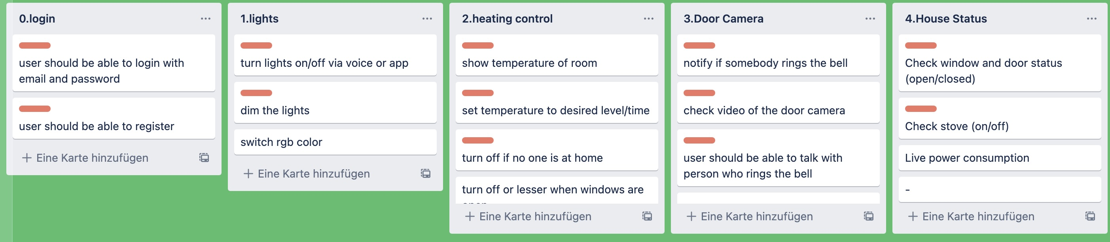
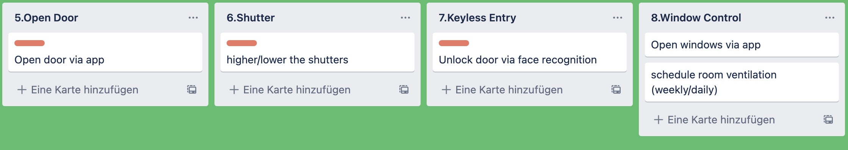
Requirements

Slide 4
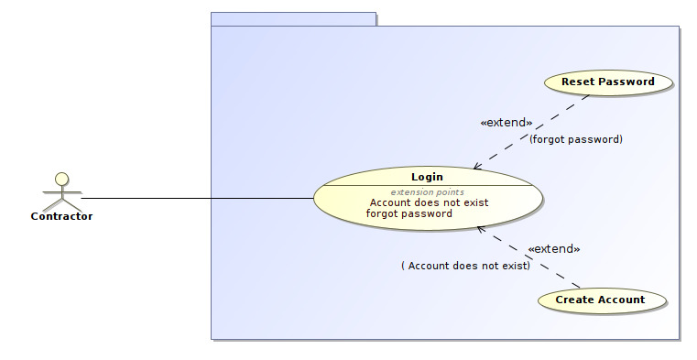
Use-Case diagram: Login

Slide 5
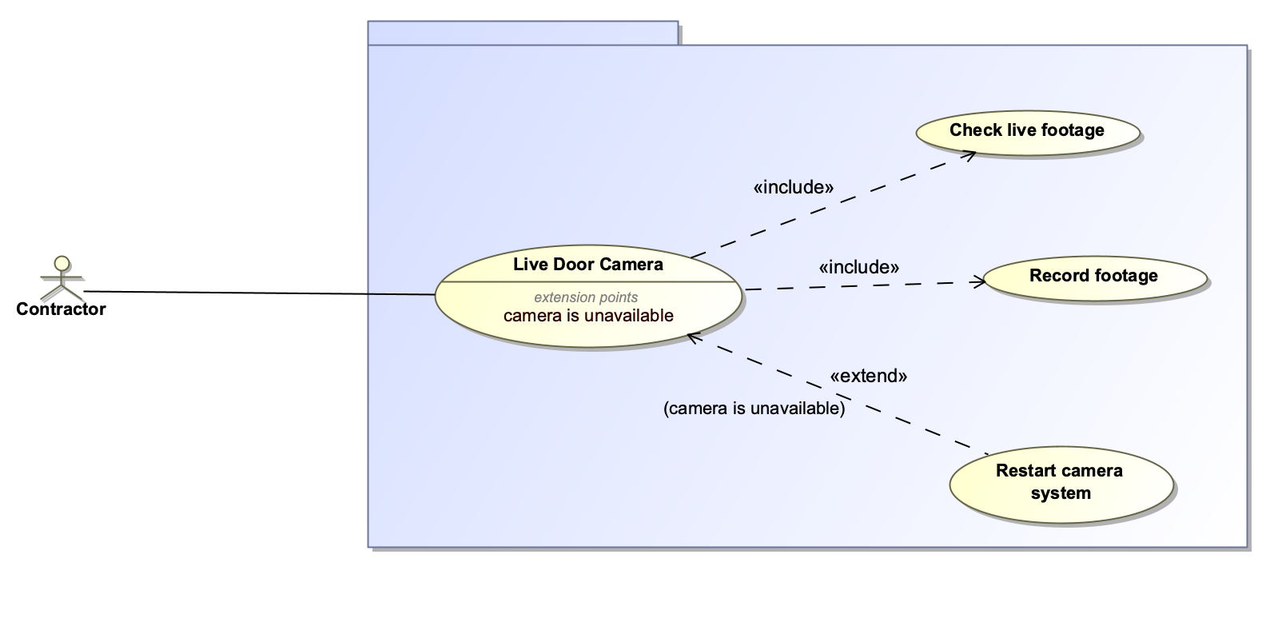
Use-Case diagram: Live Door Camera

Slide 6
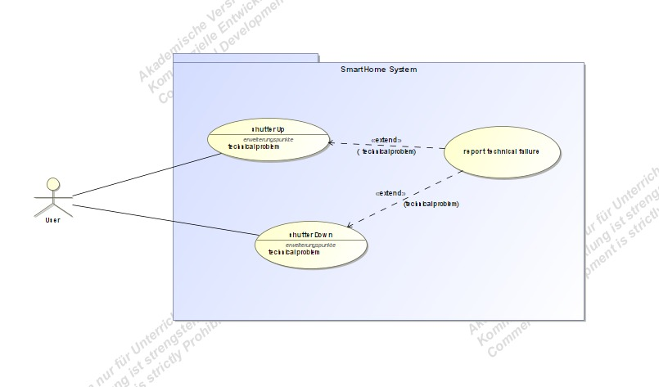
Use-Case diagram: Shutter

Slide 7
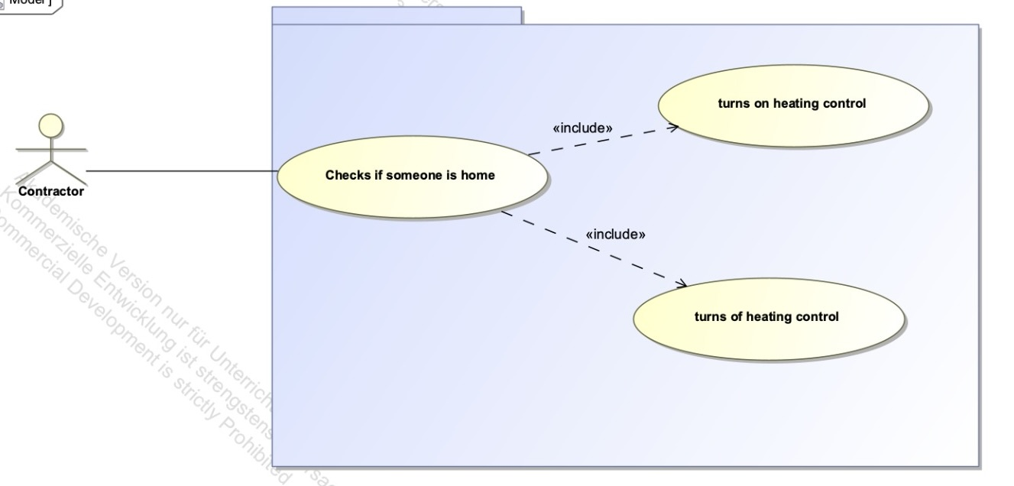
Use-Case diagram: Auto heating

Slide 8
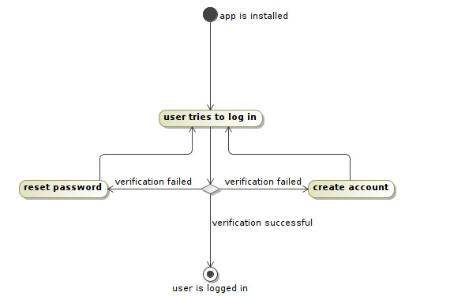
Activity diagram: Login

Slide 9
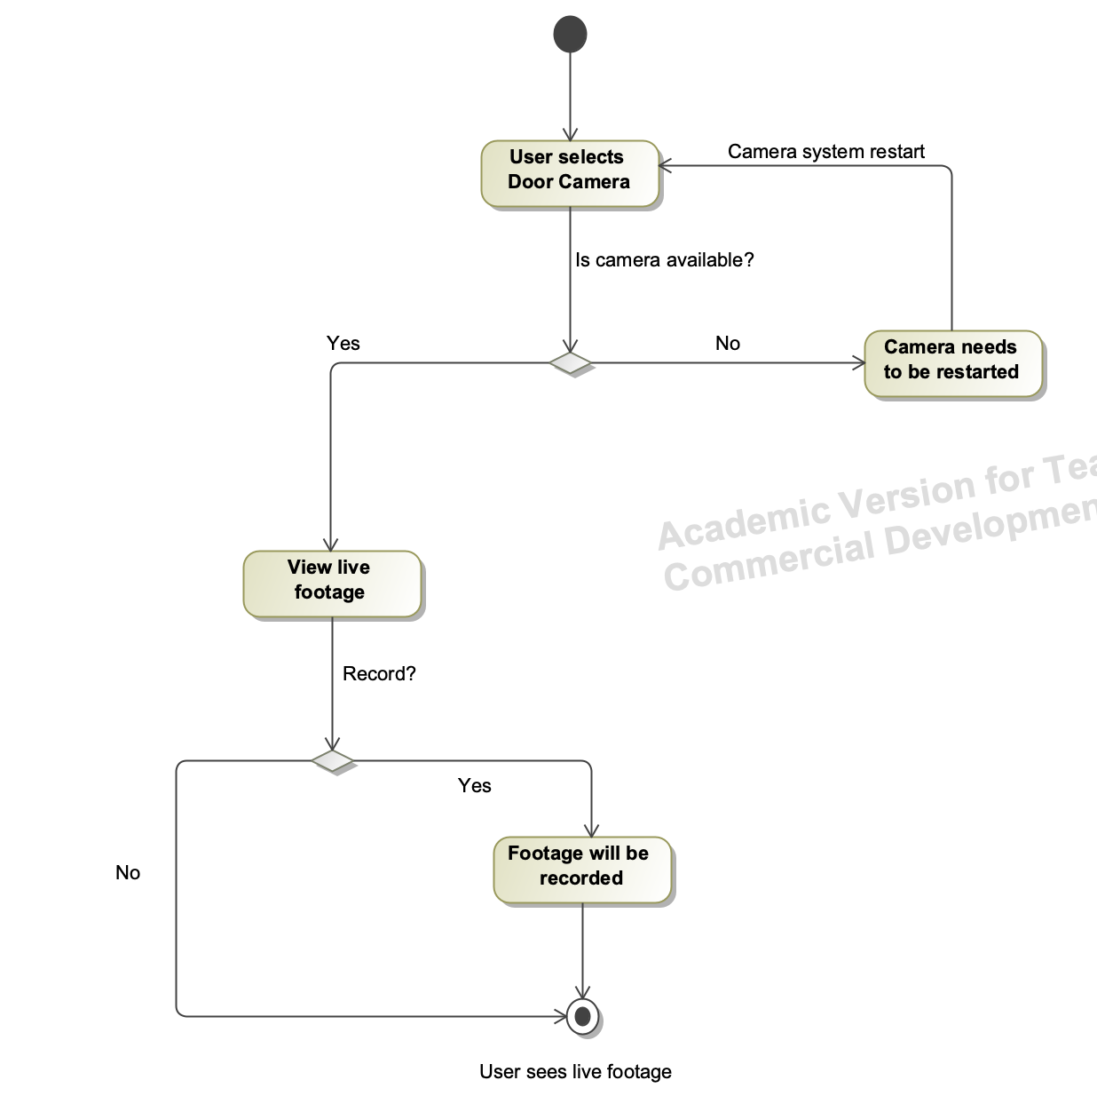
Activity diagram: Live Door Camera

Slide 10
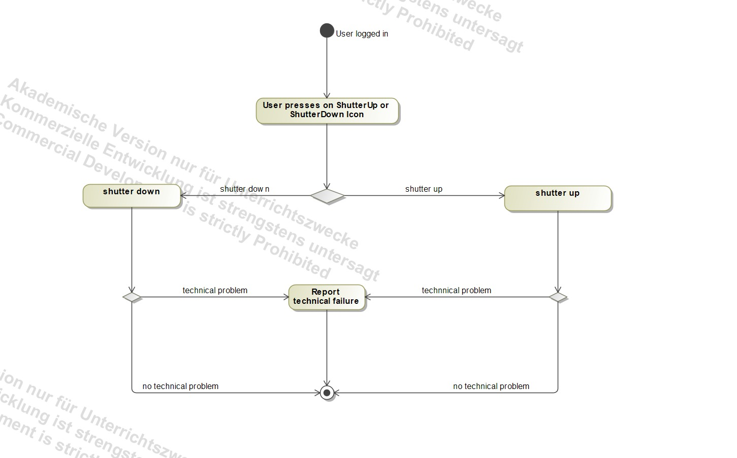
Activity diagram: Shutter

Slide 11
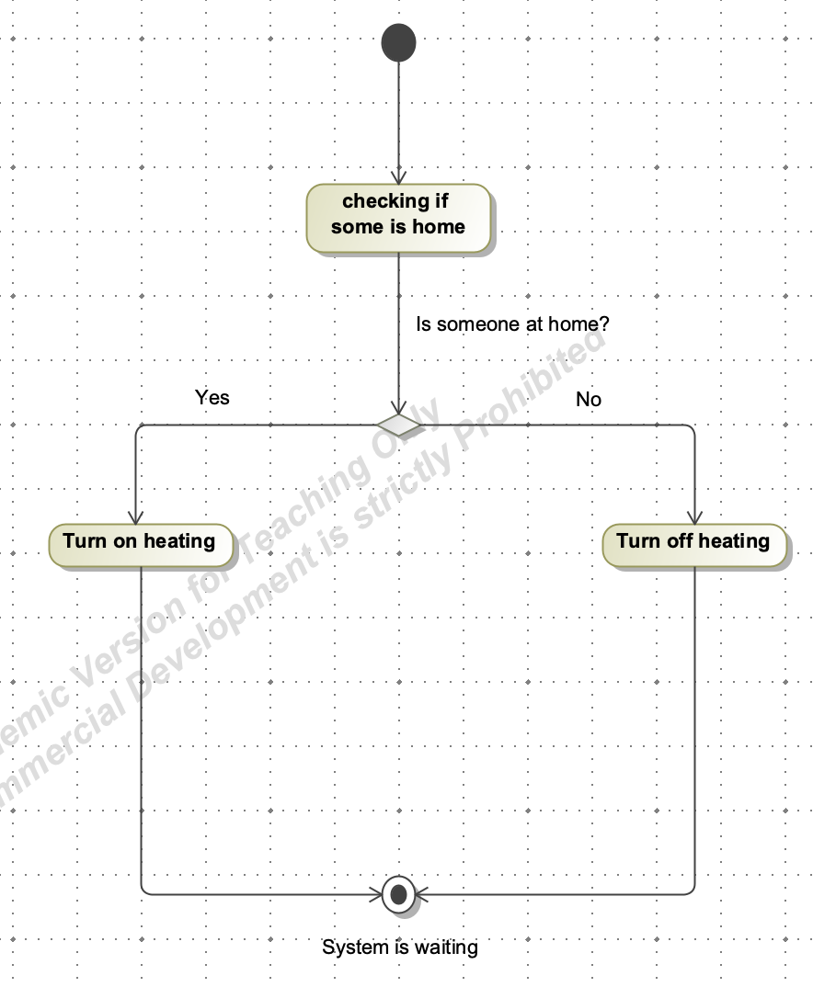
Activity diagram: Auto heating

Slide 12
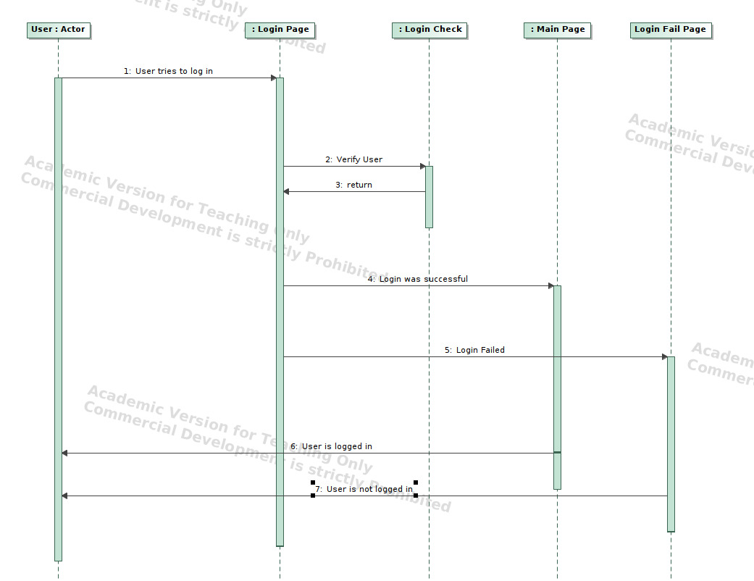
Sequence diagram: Login

Slide 13
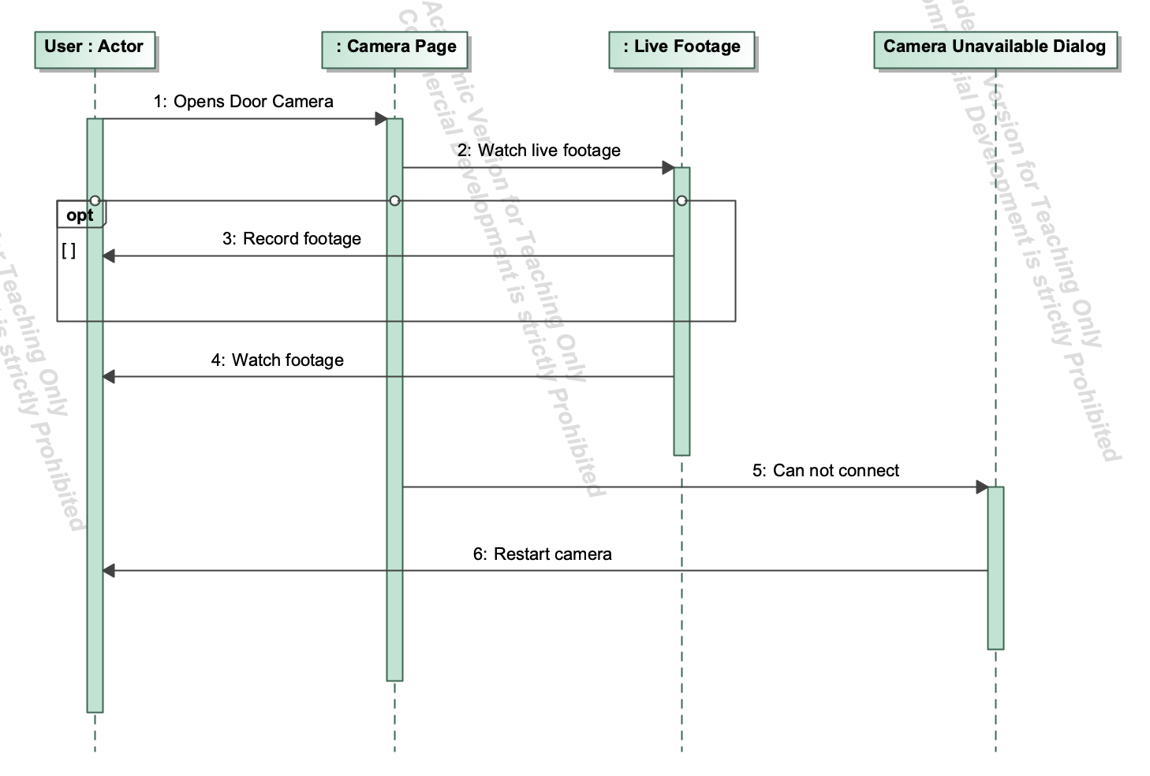
Sequence diagram: Live Door Camera

Slide 14
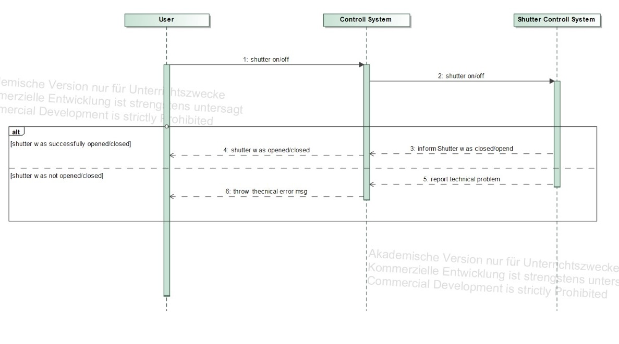
Sequence diagram: Shutter

Slide 15
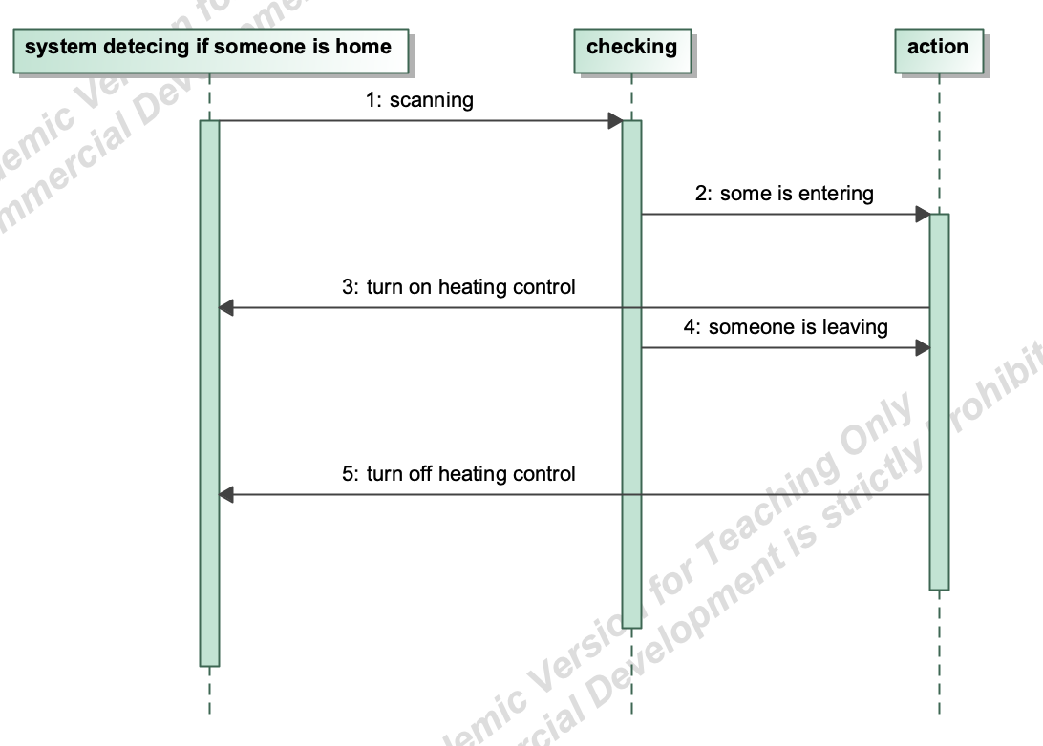
Sequence diagram: Auto heating

Slide 16
Plans for next week
Giving ID’s to requirements based on importance
UI design
Working on remaining use-case, activity and sequence diagrams
Notes:
first version class diagrams based on requirments
seqdia verstehen

